Slide 1
Remotely Controlled Nuclear Contamination Surveyor
Luke English (470412116)

Slide 2
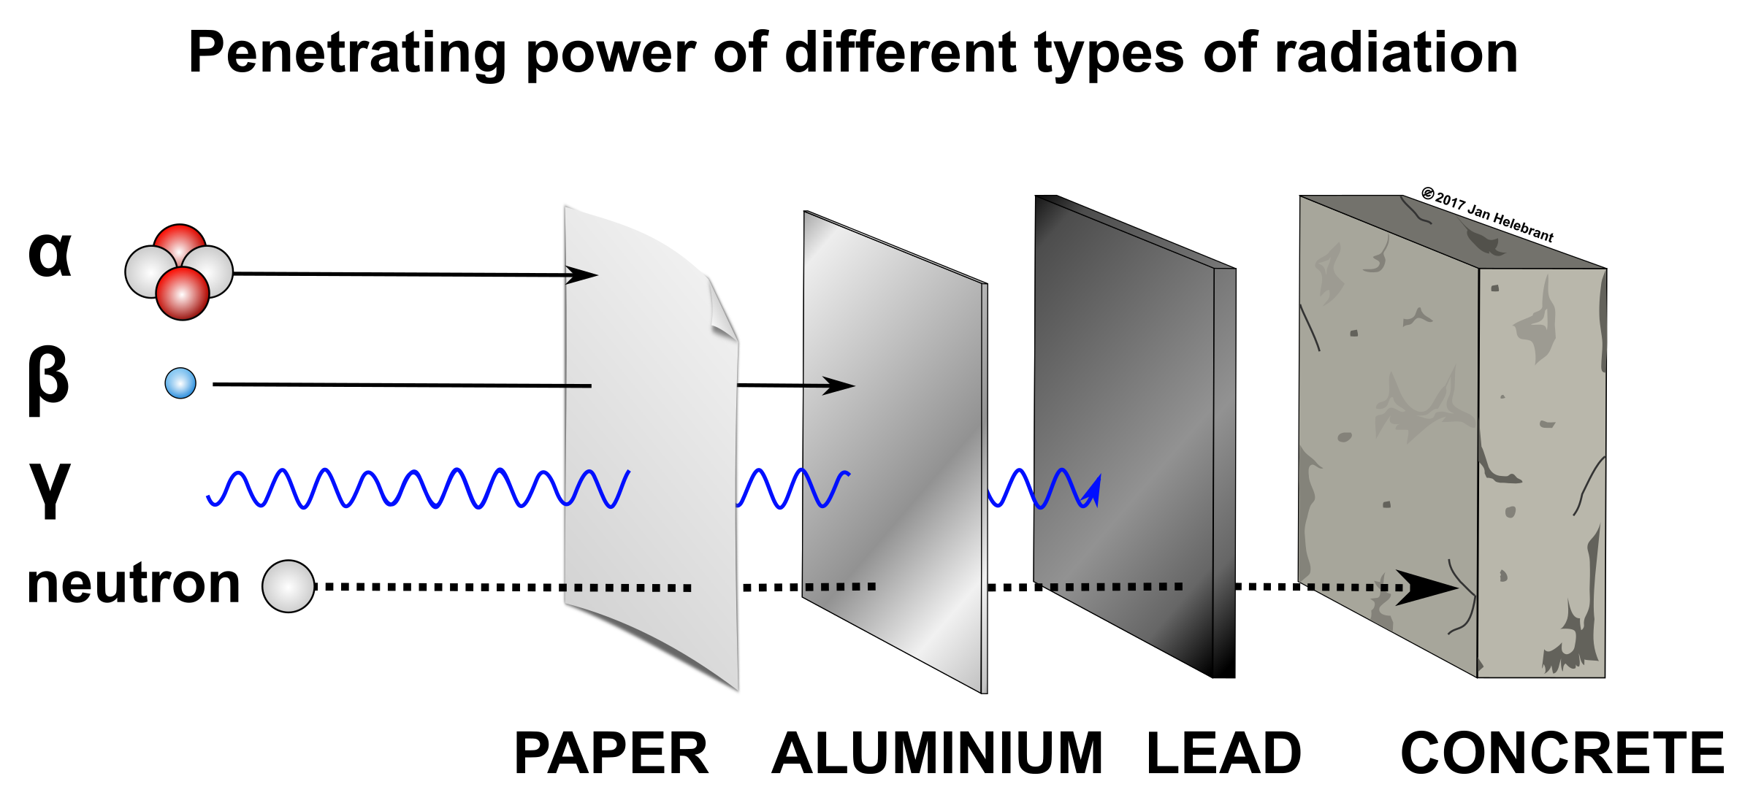
Radioactive Contamination
Unintended or undesirable presence of radioactive substances
Ionising radiation: alpha, beta, gamma

Slide 3
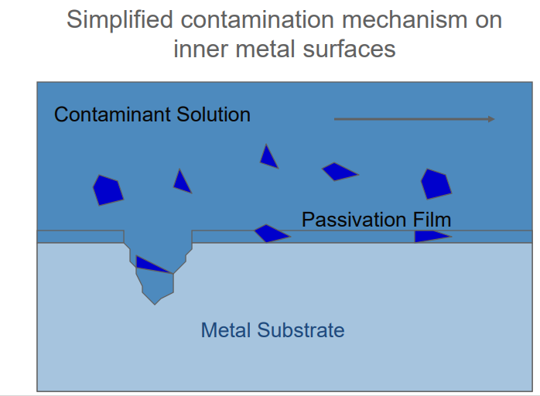
Decontamination
Decontamination is defined as the removal of contamination from areas or surfaces of facilities or equipment by washing, heating, chemical or electrochemical action, mechanical cleaning or by other means
Generally some form of decontamination – large or small ‐ is required in any decommissioning activity
Some techniques useful ex‐situ while others are useful in‐situ 3 Surface Decon

Slide 4
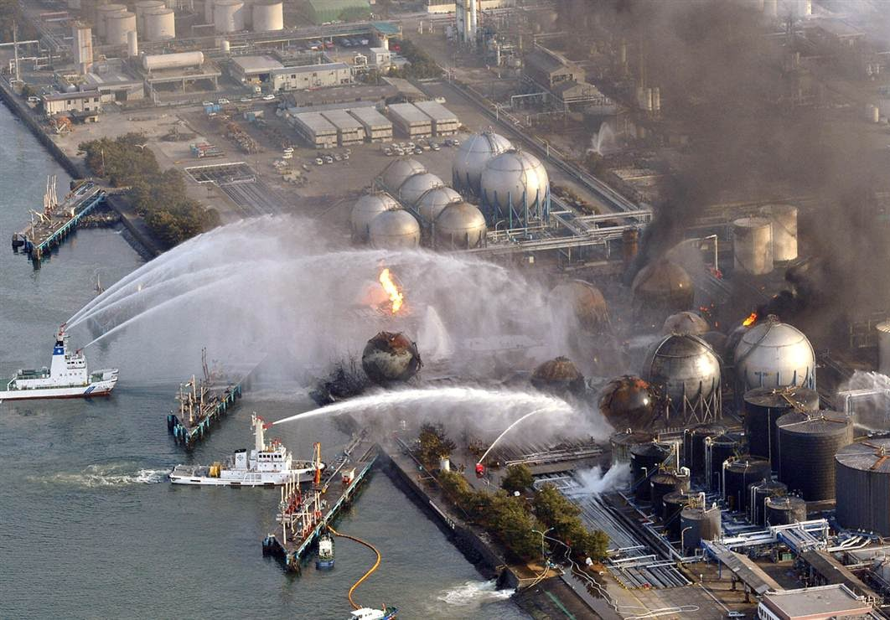
Example: Fukushima Daiichi nuclear disaster
Following a major earthquake, a 15-metre tsunami disabled the power supply and cooling of three Fukushima Daiichi reactors, causing a nuclear accident on 11 March 2011. All three cores largely melted in the first three days.
After two weeks, the three reactors (units 1-3) were stable with water addition and by July they were being cooled with recycled water from the new treatment plant. Official 'cold shutdown condition' was announced in mid-December.
Apart from cooling, the basic ongoing task was to prevent release of radioactive materials, particularly in contaminated water leaked from the three units. This task became newsworthy in August 2013.
There have been no deaths or cases of radiation sickness from the nuclear accident, but over 100,000 people were evacuated from their homes to ensure this. Government nervousness delays the return of many.
Source: http://www.world-nuclear.org/information-library/safety-and-security/safety-of-plants/fukushima-accident.aspx

Slide 5
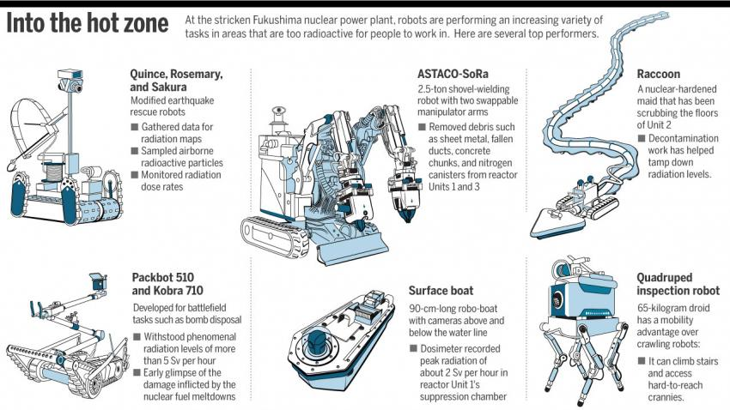
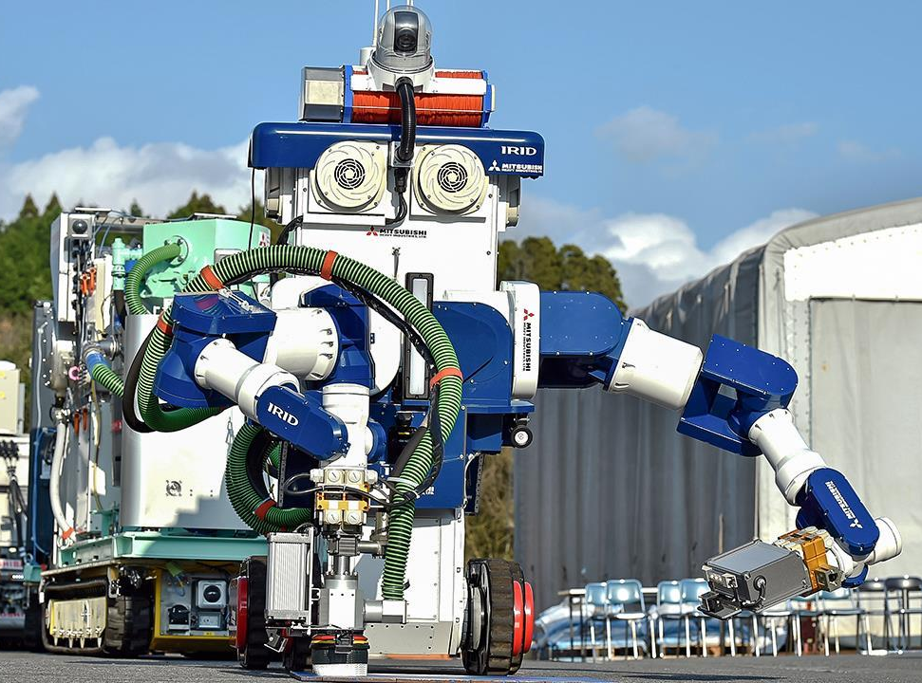
Robotic Decontamination
Source: The International Research Institute for Nuclear Decommissioning in Tokyo

Slide 6
Nuclear Contamination Detection – Geiger Counter
Device to measure ionizing radiation
Detects ionizing radiation such as alpha particles, beta particles and gamma rays using the ionization effect produced in a Geiger–Müller tube
The radiation sensor is a Geiger-Müller tube which gives out an electronic signal when radiation is present. The readout is counts or radiation dose. The counts display is commonly "counts per second". Radiation dose rate is displayed in a unit such as the sievert.

Slide 7
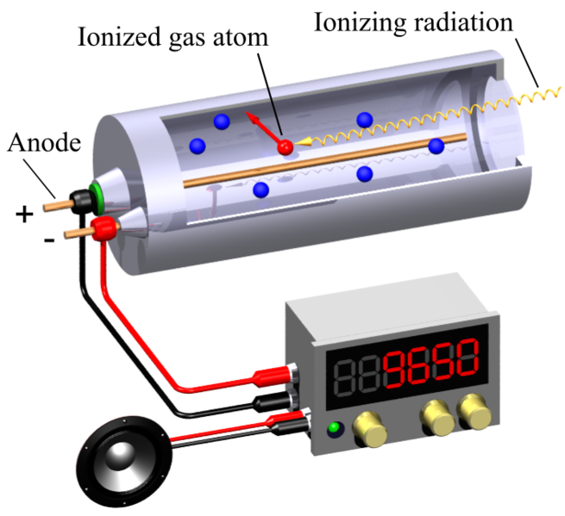
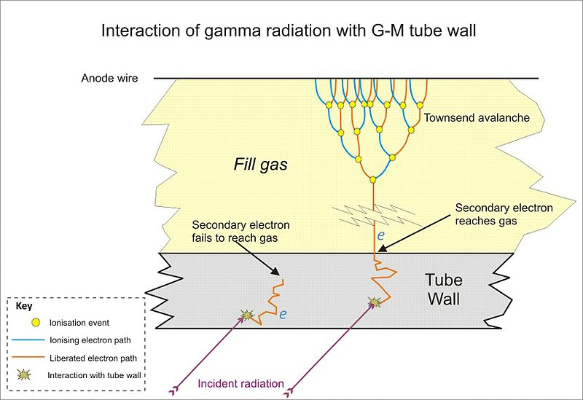
Geiger–Müller tube

Slide 8
Nuclear Contamination Surveying
Effects on environment:
Ionising radiation
Increased light levels
Increased temperatures
Need for remote controls / “sight”

Slide 9
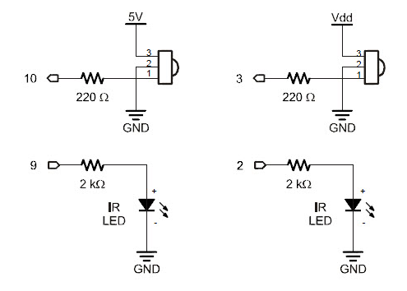
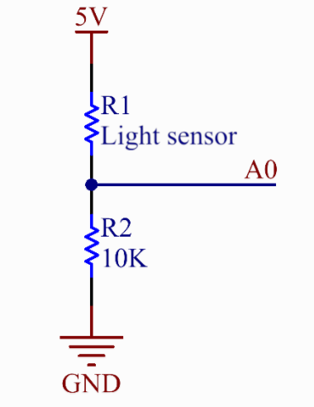
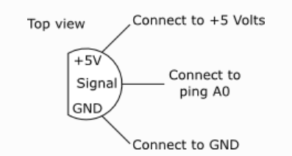
Arduino-Powered Prototype
Light Sensor
IR LED and Sensor
Temperature Sensor

Slide 10
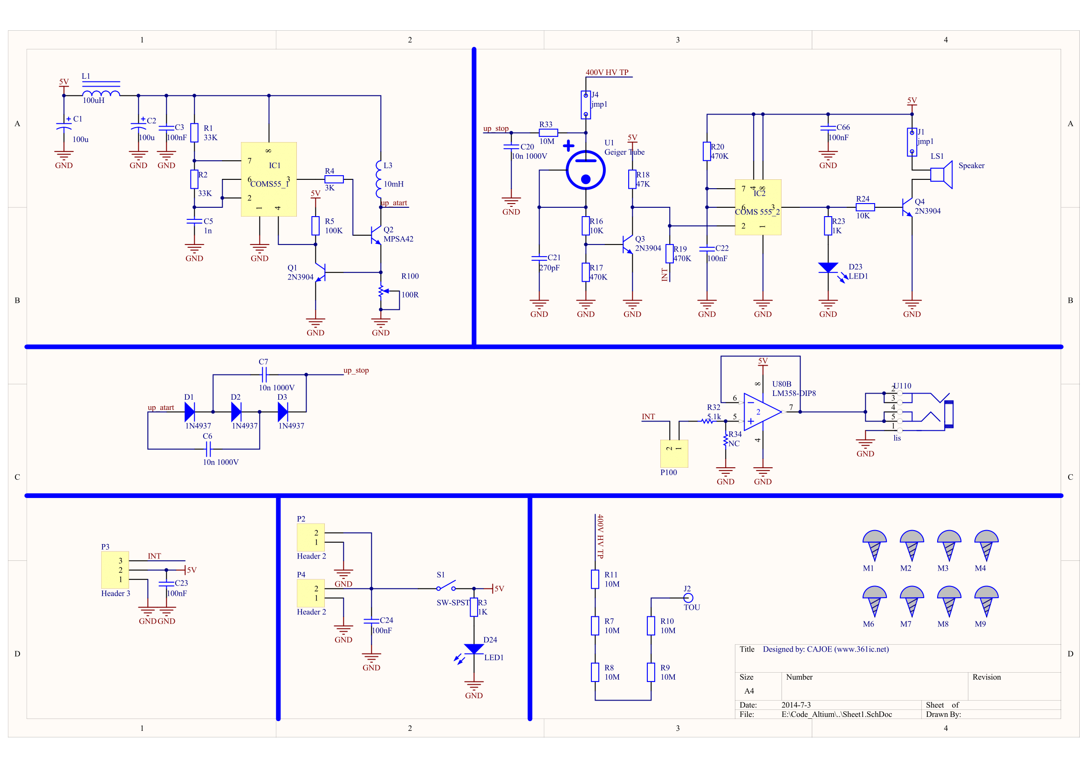

Slide 11
Arduino - AttachInterrupt
Interrupts are useful for making things happen automatically in microcontroller programs, and can help solve timing problems. Good tasks for using an interrupt may include reading a rotary encoder, or monitoring user input.
151CPM=1μSv/h
One sievert carries with it a 5.5% chance of eventually developing cancer based on the linear no-threshold model.
Source: http://www.icrp.org/publication.asp?id=ICRP%20Publication%20103
1 Sievert = 1,000,000 microsieverts

Slide 12
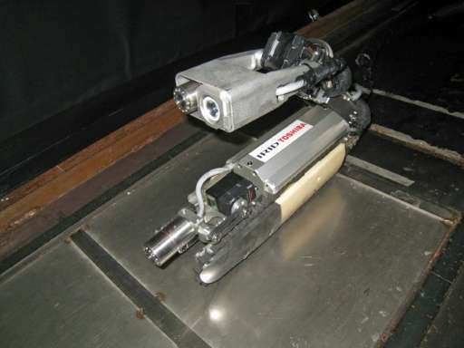
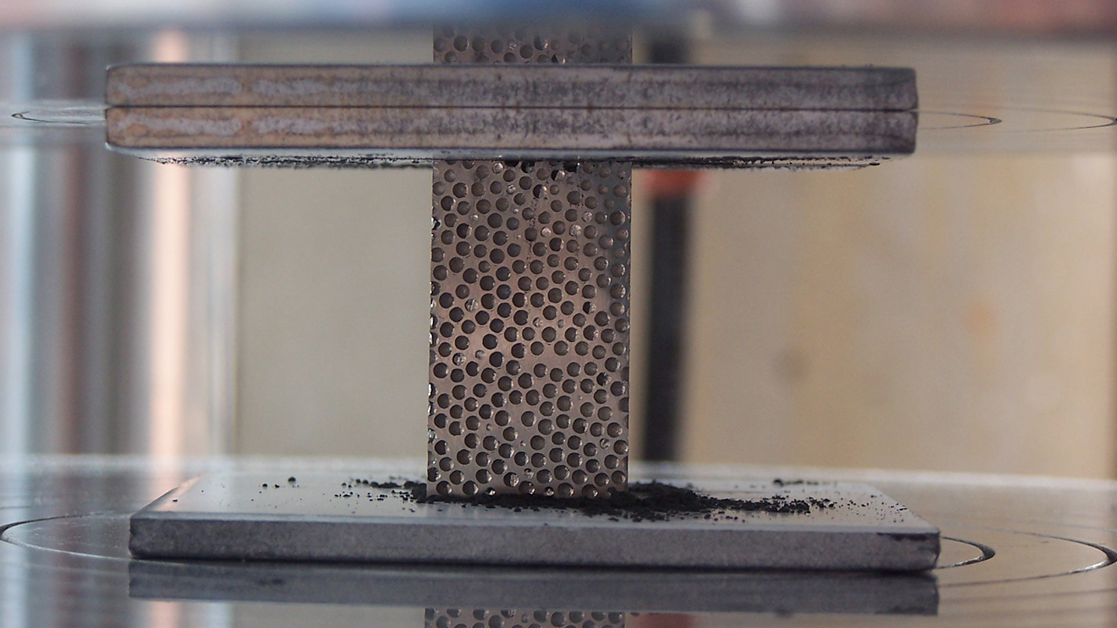
Improvements
Different method of data communication
Limitations of Bluetooth
Robotic arm
Radiation shielding
Current weakness in Fukushima clean up operations
Metal “foam”
Japanese “scorpion” robot designed to withstand 1,000 Sieverts of radiation

